Slide 1

MicroControllers
Lecture 20 – IR Sensing
Spring 2020

Slide 2
Today’s Lecture
IR Sensing
HW#9 Due Wednesday
Submit L20 Worksheet after class today
Assignment

Slide 3
Infrared Sensing

Slide 4
Infrared Sensing
Infrared (IR) sensing is used in many control applications
TV, CD, DVD, audio/video remote control
Remote control helicopters/cars
Air-conditioning / Fans
Inexpensive and easy to use wireless communication technology
IR is invisible to the eye, although longer waves may be sensed as heat

Slide 5
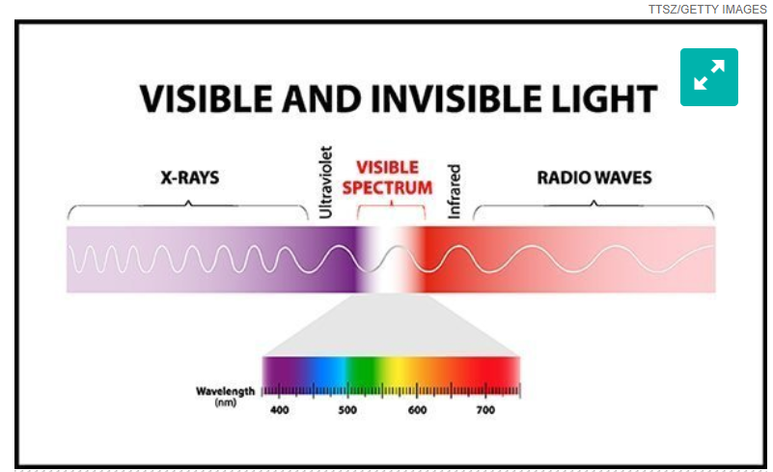
Wavelength
IR light is similar to visible light except it has a little longer wavelength
Range from 300GHz to 400THz

Slide 6
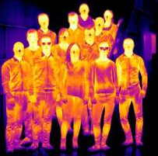

IR in Environment
IR can be created from many sources
Sun
Light bulbs
Circuit boards
Candles
Humans and animals
Anything with heat

Slide 7
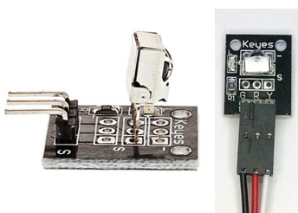
AX-1838HS
In lab you will be working with the AX-1838HS IR Receiver Module.
Miniature IR receiver
Designed specifically for remote control applications
Integrates sensor preamplifier and interface IC
Outputs are CMOS and TTL compatible

Slide 8
IR Modulation
Goal is to transfer a short sequence of bits
Receiver must be sensitive to transmitter but reject other sources of IR (ex. Sun or Lights)
Common modulation scheme is 38kHz pulse modulation, but carrier frequencies between 30kHz and 60kHz are often used

Slide 9
38kHz Pulse Modulation
Assume the remote transmitter in your lab is attempting to send the following byte : 10001010
Volts
Time

Slide 10
38kHz Pulse Modulation
To send a zero, transmitter remains off
To send a one, transmitter flashes at 38kHz
Volts
Time

Slide 11
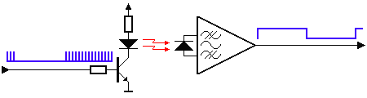

Transmitting and Receiving
SBProjects.com
Notes:
Click picture for animation.

Slide 12
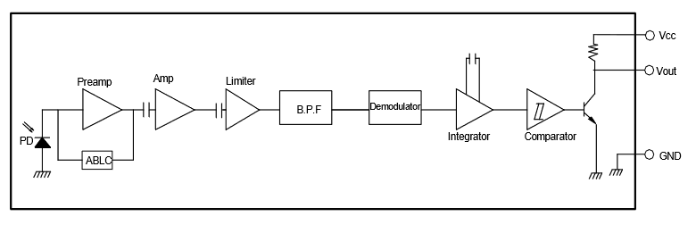
Receiver
Must be chosen for correct modulation
PD – Detection Diode receives original signal
Preamp / Amp – Amplifies signal
Limiter – Assists in obtaining a constant pulse level
BPF – Tuned to carrier frequency (38kHz)
Demodulator / Integrator / Comparator
Work together to detect carrier frequency
If frequency is present, comparator output is low

Slide 13
Keys and Codes
Each button press results in a transmitted value
Print each key value to the serial monitor
Determine which code represents which key
Assign helpful names to each code value
#define UP 0xFF629D
#define DOWN 0xFFA857
#define LEFT 0xFF22DD
#define RIGHT 0xFFC23D
#define CENTER 0xFF02FD
#define ONE 0xFF6897
#define TWO 0xFF9867
#define THREE 0xFFB04F

Slide 14
IR libraries
In lab we will be working with the IRremote library. The header file below must be included.
#include <IRremote.h>
Assign input pin
Set up to use the library functionality

Slide 15
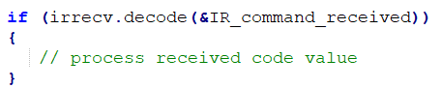
Receive Data Using Library
To receive data call the decode function below
Decodes the received IR message
Returns 0 if no data ready, 1 if data ready
Results of decoding are stored in the argument
We will be using the results stored in IR_command_received.value

Slide 16
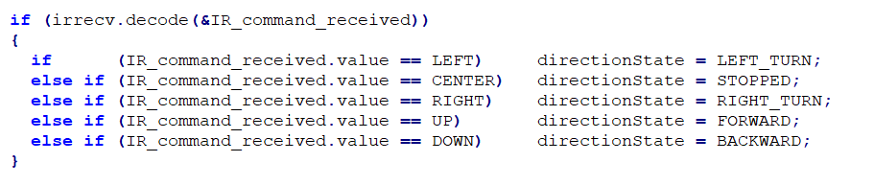
Create Function to Decode Key Codes
Use the received key code to change the directionState of your state machine

